Slide 1

Flight Booking Management & Analytics Portal for Airline & Airport
Team Members Details
L. Sainath –2520090148
2.M Naman –252009094
3.M.abhi sai sagar –2520090173
II Year B.Tech-I Semester – CS&IT
Under the Guidance of
Dr.M Gayatri
Associate Professor
‹#›
B.Tech II Year – I Sem | Dept of CS&IT

Slide 2


Agenda
Abstract
Introduction
Existing System
Proposed System
System Architecture
Requirements Specifications
System Models
Conclusion
‹#›
B.Tech II Year – I Sem | Dept of CS&IT

Slide 3
Abstract
The project is a database-driven web application for managing airline and airport operations.
It manages passengers, flights, bookings, baggage, check-in, and notifications.
Passengers can search for flights, create bookings, manage their reservations, and complete check-in.
Administrators and airline staff can manage flight and passenger information through role-based access.
A centralized MySQL database maintains consistent and organized records.
An Analytics Dashboard provides useful insights into bookings, passengers, and flight operations.
‹#›
B.Tech II Year – I Sem | Dept of CS&IT

Slide 4
Introduction
Problem Background
Airline operations involve large amounts of interconnected data such as:
Passenger information
Flight schedules
Booking details
Baggage records
Check-in information
Airport operations
Managing these records manually or through disconnected systems can lead to:
Data duplication
Difficulty in retrieving information
Booking management issues
Poor tracking of operational activities
Limited reporting and analytics
Our project provides one integrated system to solve these problems.
‹#›
B.Tech II Year – I Sem | Dept of CS&IT

Slide 5
Existing System
Existing Approach
Traditional/basic airline booking systems may have separate processes for:
Passenger registration
Flight search
Ticket booking
Baggage management
Check-in
Reporting
Limitations
Information may be distributed across different systems
Difficult to track the complete booking lifecycle
Limited analytics and reporting
Manual management can cause errors
Limited activity tracking
Inefficient retrieval of operational information
Main drawback:
Lack of an integrated platform connecting booking, passenger, flight, baggage, check-in, and analytics data.
‹#›
B.Tech II Year – I Sem | Dept of CS&IT

Slide 6
Proposed System
Our proposed system integrates all major airline booking operations into a single database-driven portal.
Key Features
Passenger Registration & Role Management
Flight Search & Filtering
Flight Booking & Booking Lifecycle Management
Baggage Management
Check-In Management
Notifications
Audit Logs
Analytics Dashboard
JWT-based Authentication & Role-Based Access
Advantages
Centralized data management
Reduced data redundancy
Faster information retrieval
Better data consistency
Secure access
Improved reporting and analytics
‹#›
B.Tech II Year – I Sem | Dept of CS&IT

Slide 7
System Architecture
User
↓
React.js
↓
Node.js + Express.js
↓
Sequelize ORM
↓
MySQL Database
↓
Analytics – Chart.js
‹#›
B.Tech II Year – I Sem | Dept of CS&IT

Slide 8
Requirements Specifications
Functional Requirements
The system should allow:
User registration and login
Role-based access
Flight searching and filtering
Flight booking
Booking modification/cancellation
Passenger information management
Baggage management
Check-in management
Notifications
Audit logging
Analytics and report generation
Non-Functional Requirements
Security — authenticated and authorized access
Reliability — consistent database operations
Performance — fast search and retrieval
Scalability — ability to handle increasing records
Usability — simple and user-friendly interface
Data Integrity — accurate and consistent database records
‹#›
B.Tech II Year – I Sem | Dept of CS&IT

Slide 9
System Models
Passenger → Booking → Flight
Booking → Payment
Booking → Baggage
Booking → Check-in
User → Role
User → Audit Log
‹#›
B.Tech II Year – I Sem | Dept of CS&IT

Slide 10
Analytics Dashboards
The system can generate visual reports such as:
Total bookings
Confirmed / cancelled bookings
Passenger statistics
Most booked flights
Booking trends
Flight-wise booking distribution
Baggage statistics
Check-in statistics
‹#›
B.Tech II Year – I Sem | Dept of CS&IT

Slide 11
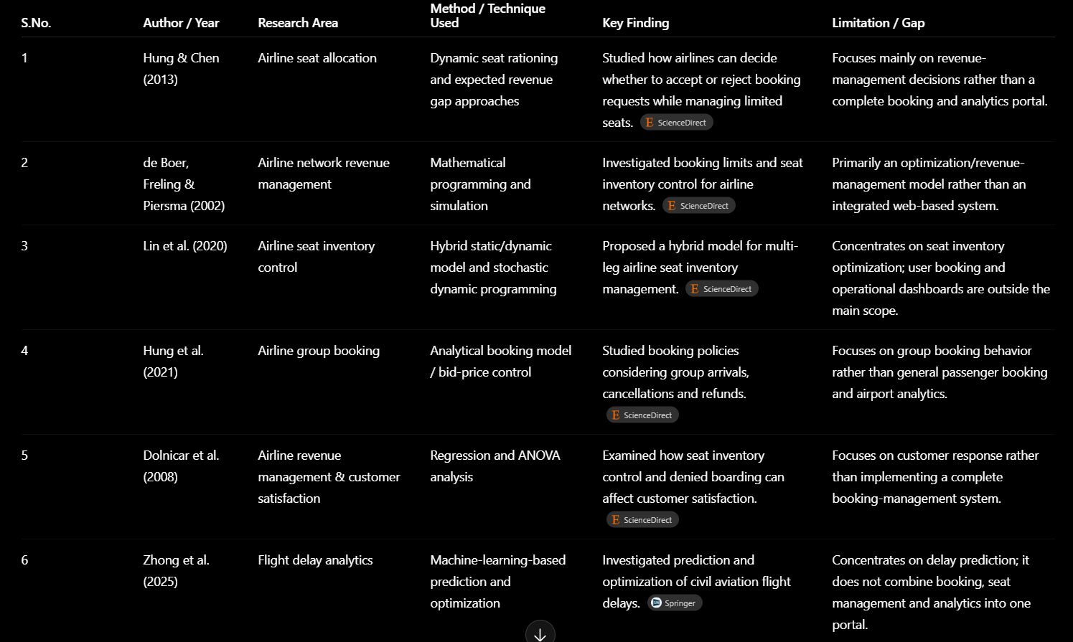
Literature Review
‹#›
B.Tech II Year – I Sem | Dept of CS&IT

Slide 12
Critical Analysis & Synthesis
Critical Analysis:
The initial system provided core flight searching and booking functionality but had limited flight coverage, basic seat selection, limited admin analytics and demo-only payment. The enhanced SkyBook system improves scalability and usability through a larger flight database, smart search, live seat availability, customer booking management and analytical dashboards.
Synthesis:
User Interface (UI): The frontend application where users interact with the system.
Smart Flight Search: The specific feature or module within the UI where users input parameters to search for flights.
REST API: The communication layer that transmits the user's search requests from the frontend to the backend server.
Node.js + Express: The backend application server framework that receives the API requests and handles business logic.
MySQL Database: The relational database management system where persistent data is stored.
Flight / User / Booking Data: The actual data entities and records structured inside the MySQL database tables.
Customer Portal + Admin Analytics: The final dashboards or views powered by this data, serving both the end-user (booking history) and administrators (business analytics).
‹#›
B.Tech II Year – I Sem | Dept of CS&IT

Slide 13
Conclusion
The proposed system provides an integrated platform for airline and airport operations.
It manages the complete flight booking lifecycle from flight search to check-in.
A centralized MySQL database improves data consistency, integrity, and accessibility.
Role-based access improves system security.
Analytics and reporting help administrators understand operational and booking trends.
The project demonstrates practical applications of DBMS concepts, backend development, authentication, and data visualization
‹#›
B.Tech II Year – I Sem | Dept of CS&IT

